Slide 1
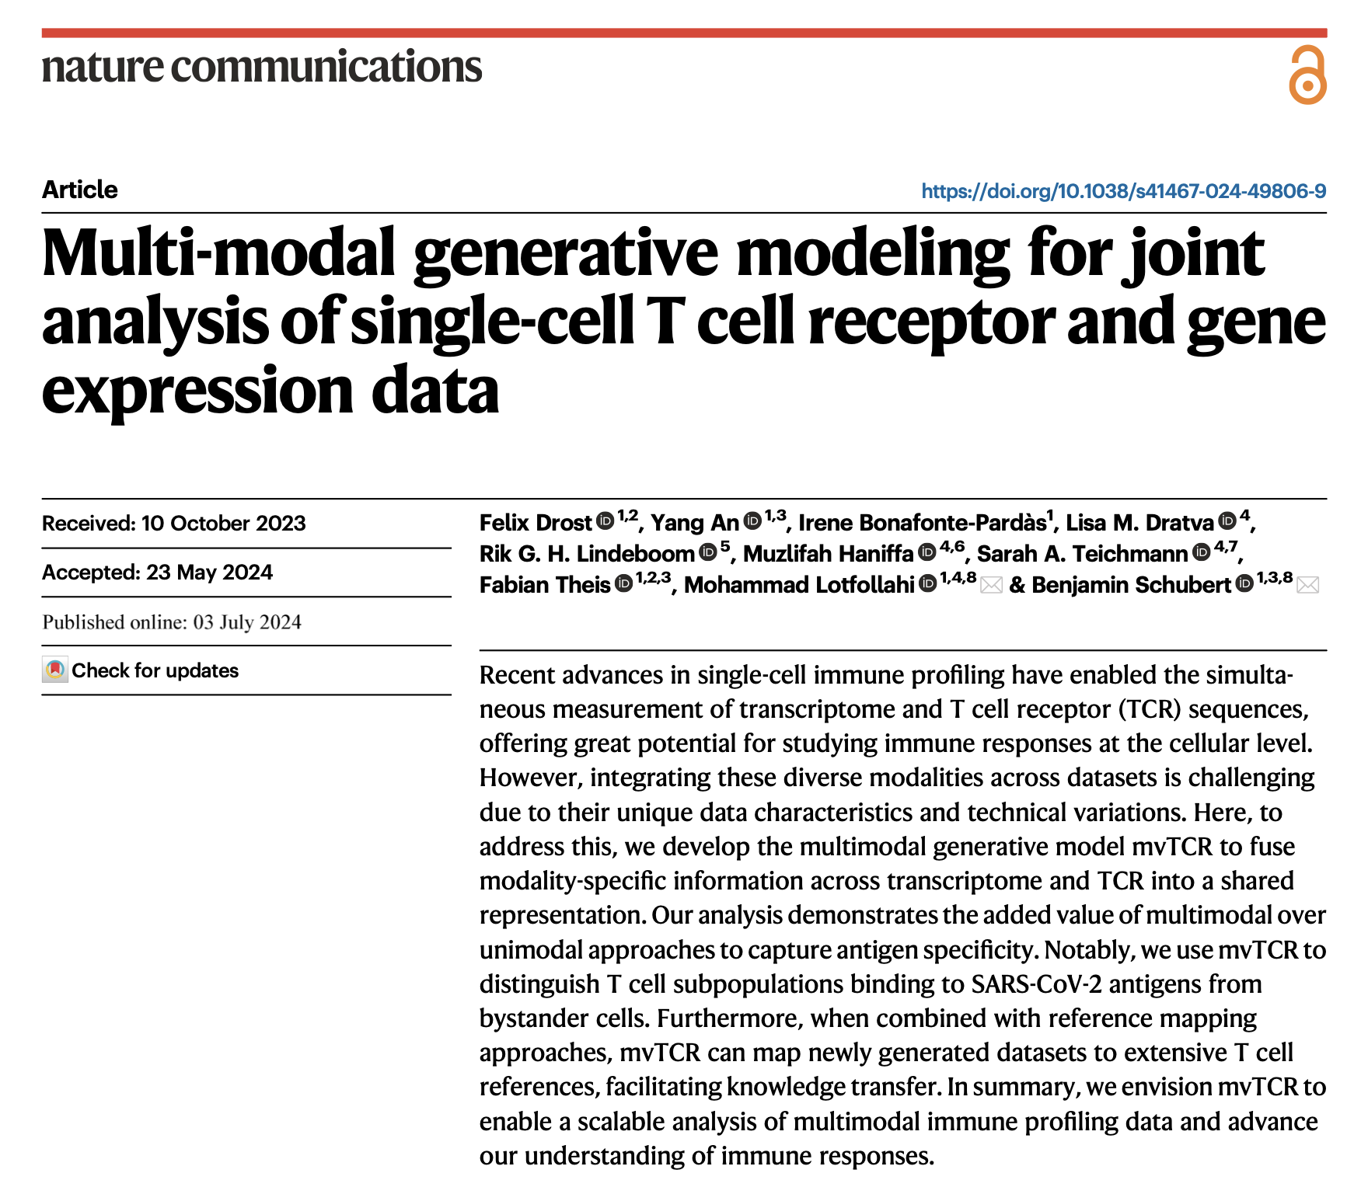
Journal club
9-3-2024
Ty Bottorff

Slide 2
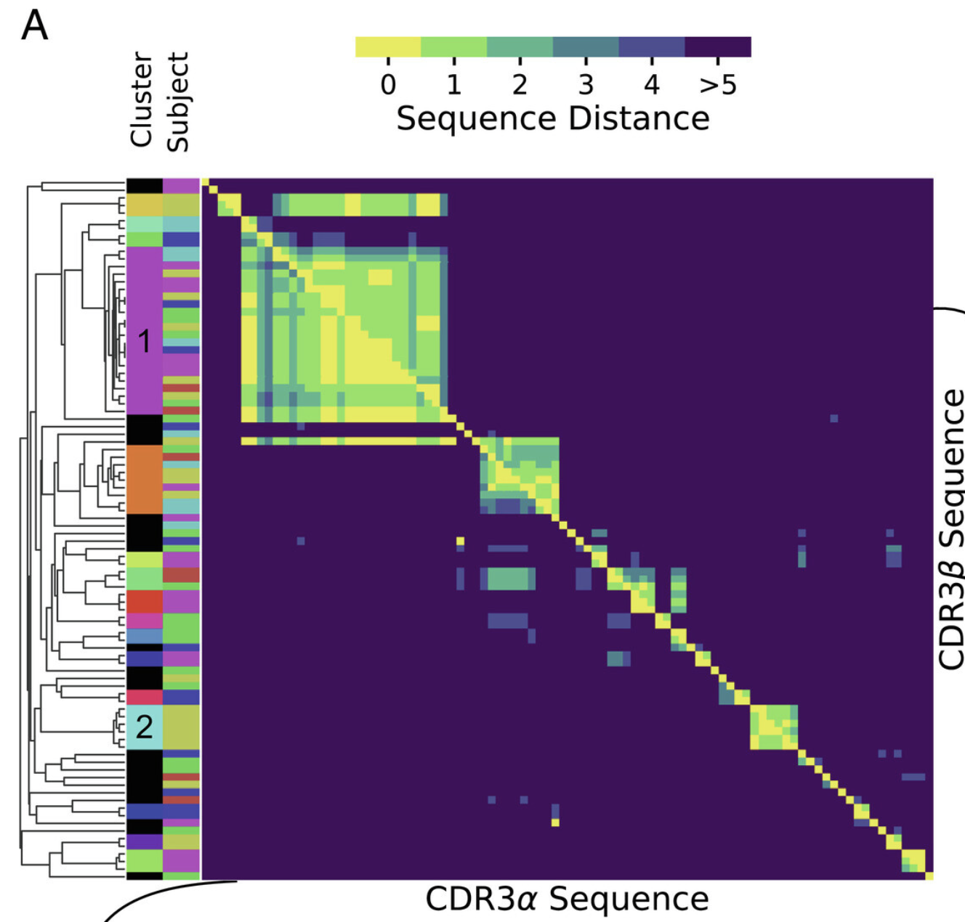
TCRs with similar sequences often bind same epitope, but dissimilar TCRs may bind same epitope (distinct binding mode)
Mayer & Callan Jr. (2023) PNAS
Notes:
While TCRs with similar sequences often—but not always—recognize the same epitope19, dissimilar TCRs may bind the same epitope through distinct binding modes20, which poses a major challenge for approaches purely based on sequence similarity.
Fig. 1A shows a clustering by pairwise amino acid sequence distance of all distinct nucleotide sequence clones. In this visualization, each position in the heatmap records the sequence distance Δ between the amino acid sequences of a pair of distinct T cell clones. TCRs are heterodimeric, and the heatmaps above (below) the diagonal record distances between the β(α) hypervariable complementary-determining region 3 (CDR3) loops of the sequence pair. Clustering is based on the sum of distances between α and β chains. Here, and throughout this work, we define sequence distances as the minimal number of edits (insertions, deletion, or substitutions) that change one sequence into another, known as the Levenshtein distance. We only consider sequence distances between CDR3 loops for simplicity, but the mathematical framework we develop is general and could also be used with distance measures that include other hypervariable receptor regions. By clones we mean lineages of cells that go back to the same ancestral recombination event, which we define in practice based on nucleotide sequence identity. A zero distance pair arises when due to convergent recombination two distinct nucleotide sequences have the same amino acid translation. We chose to ignore the number of times a given nucleotide sequence is sampled, as clone sizes also reflect TCR-independent lineage differences (31, 32). Instead, we analyze convergent selection imposed on distinct clones with the same or similar TCR as a stringent measure of epitope-driven functional selection. In the experiments that we consider in this manuscript, TCRs are selected for binding to a specific pMHC ligand, and our analysis quantifies the imprint of this filtering funnel on TCR sequence statistics. We use the word “selection” to refer to this filtering process, which is distinct from, and not to be confused with, thymic selection.

Slide 3
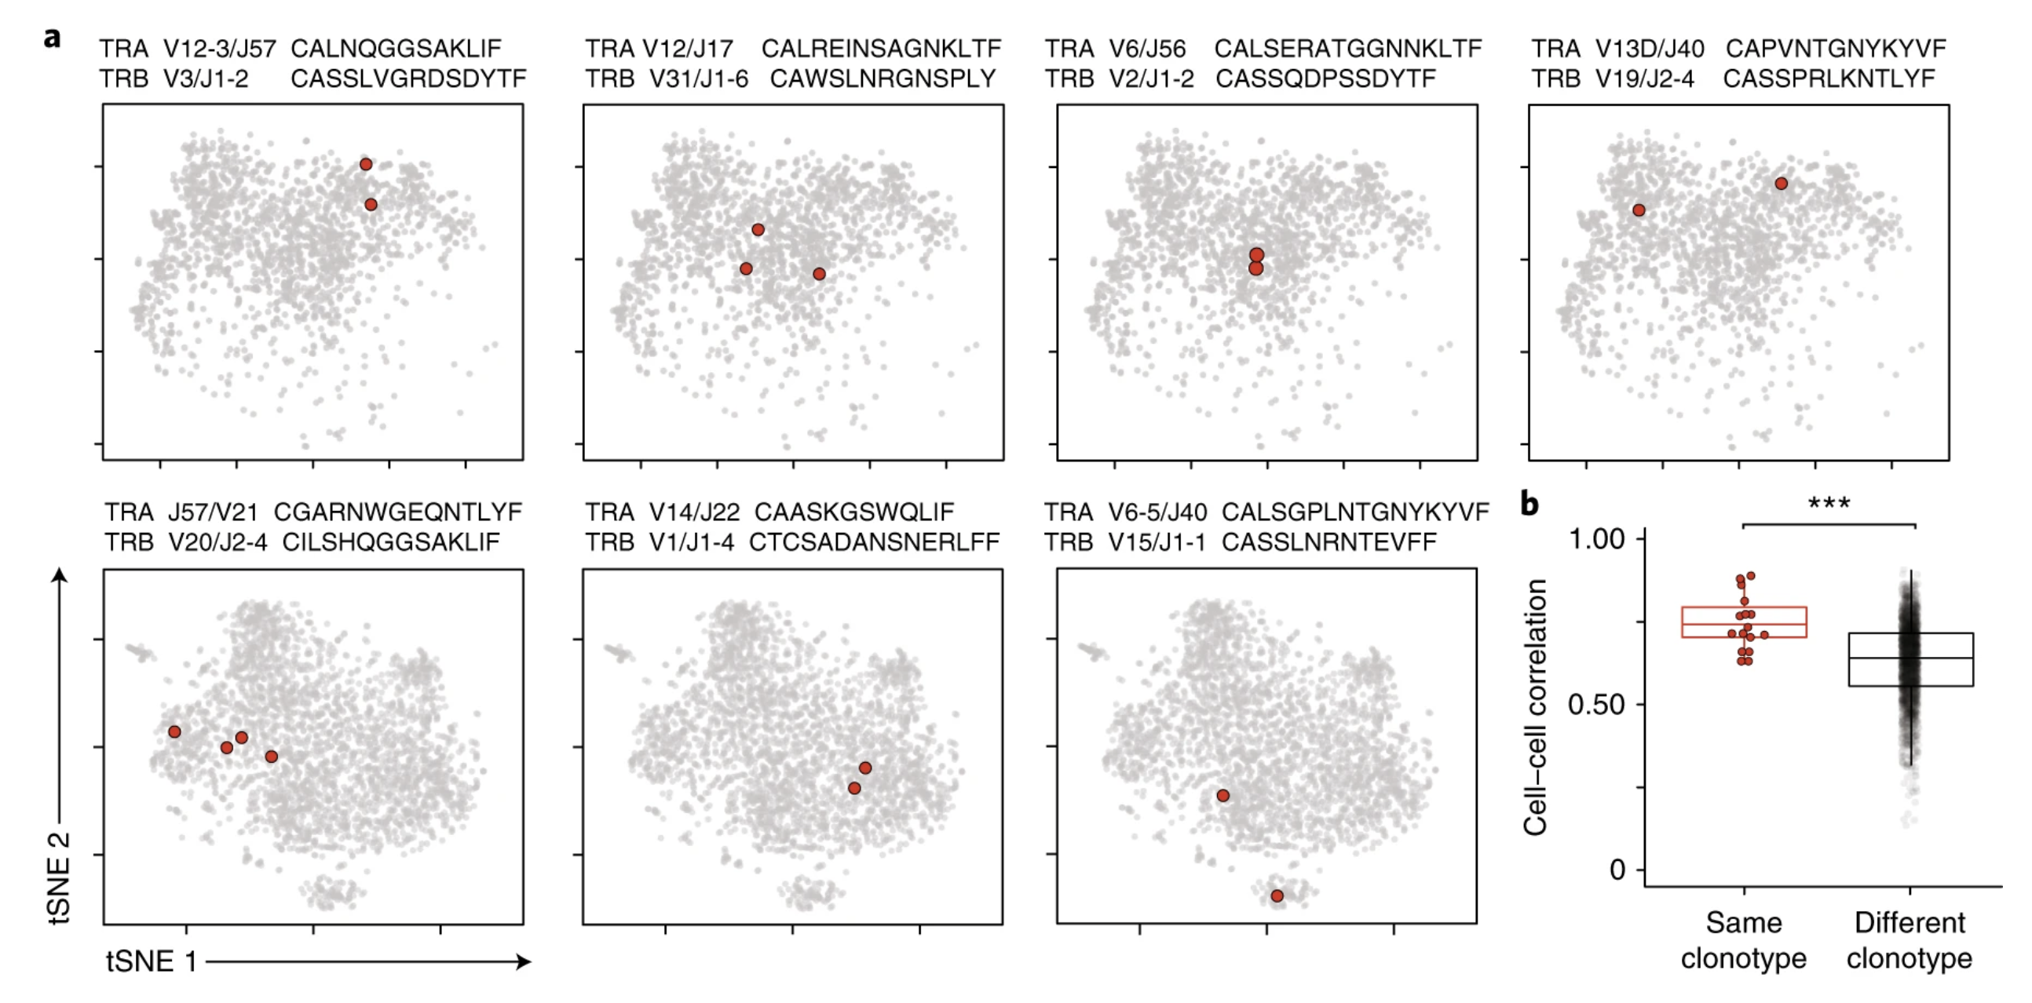
Clonotypes are often similar phenotypically
Zemmour et al. (2018) Nat Immunol

Slide 4
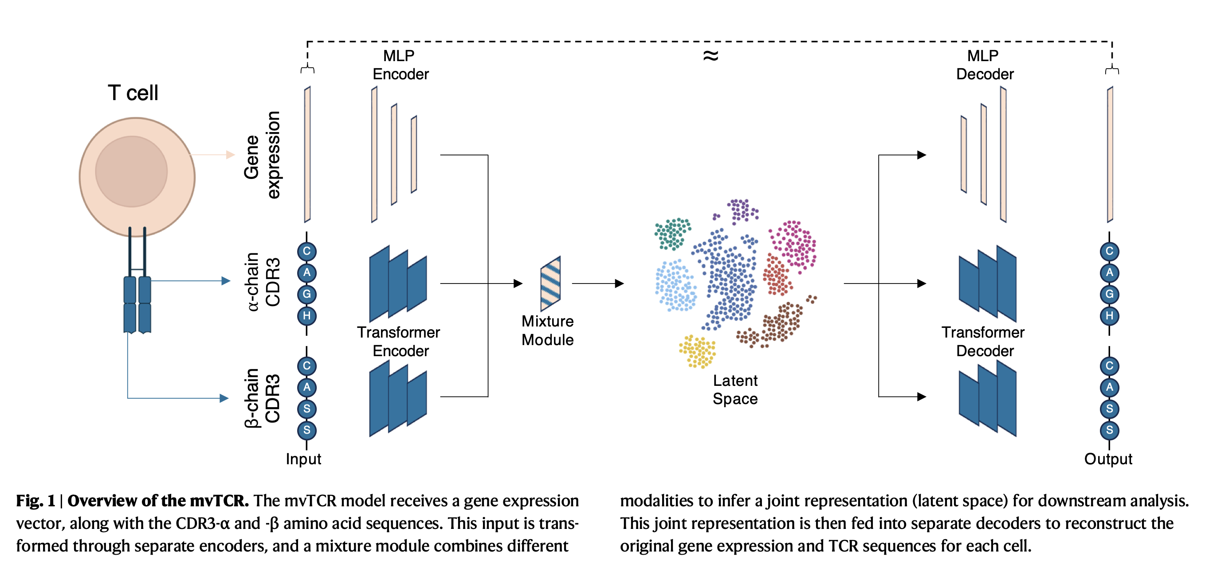
mvTCR: a multi-view deep learning generative model for integrating TCR and transcriptome
Notes:
hopefully providing value over unimodal approaches (identify groups of functionally/clonally linked T cells) → better understand inter-dependencies between these 2 modalities
Generative model based on a deep variational autoencoder that receives gene expression data and CDR3 AA sequences from TCR alpha and beta chains for each cell → multi-layer perceptron (MLP) to embed gene expression data to lower-dimensional representation
Transformer network learns contextual representation of each residue (attends to position and other AAs), residue-level representation aggregated by an MLP to derive sequence-level representation of TCR
After encoding both modalities individually, mixture model used to fuse modalities into a shared representation for each cell
Concatenation: combines both latent embeddings as input to additional encoding network estimating distribution
Product of experts: first estimates separate marginal posterior distributes, then fused via multiplication to form joint posterior distribution
Mixture of experts: same as PoE but addition instead
Availability of paired scRNA + scTCR multiomic data
Multimodal generative model mvTCR: fuse modality-specific information across transcriptome and TCR into shared representation
added value of multimodal over unimodal approaches to capture antigen specificity
integration tools exist for other modality combos like RNA + surface protein, they aren't adapted for TCR
mvTCR provides a cell-level embedding incorporating both modalities
integrates into standard single-cell analysis workflow
scales well to atlas-level analysis
Both CDR3 sequences are tokenized and zero-padded to themaximalsequencelengthseqpresentinD.Inthefollowing,xiTRA and xiTRB are summarized as xiTCR when both chains are considered. xiRNA 2 Rgenes comprises the 5000 most highly variable genes, whose read counts were normalized and log1p-transformed.

Slide 5
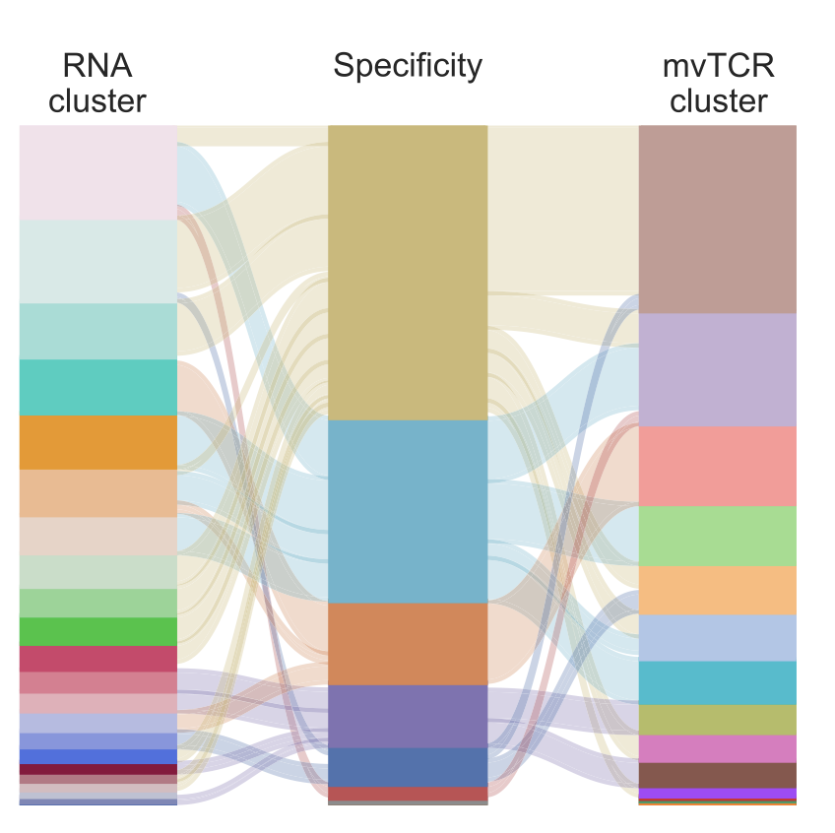
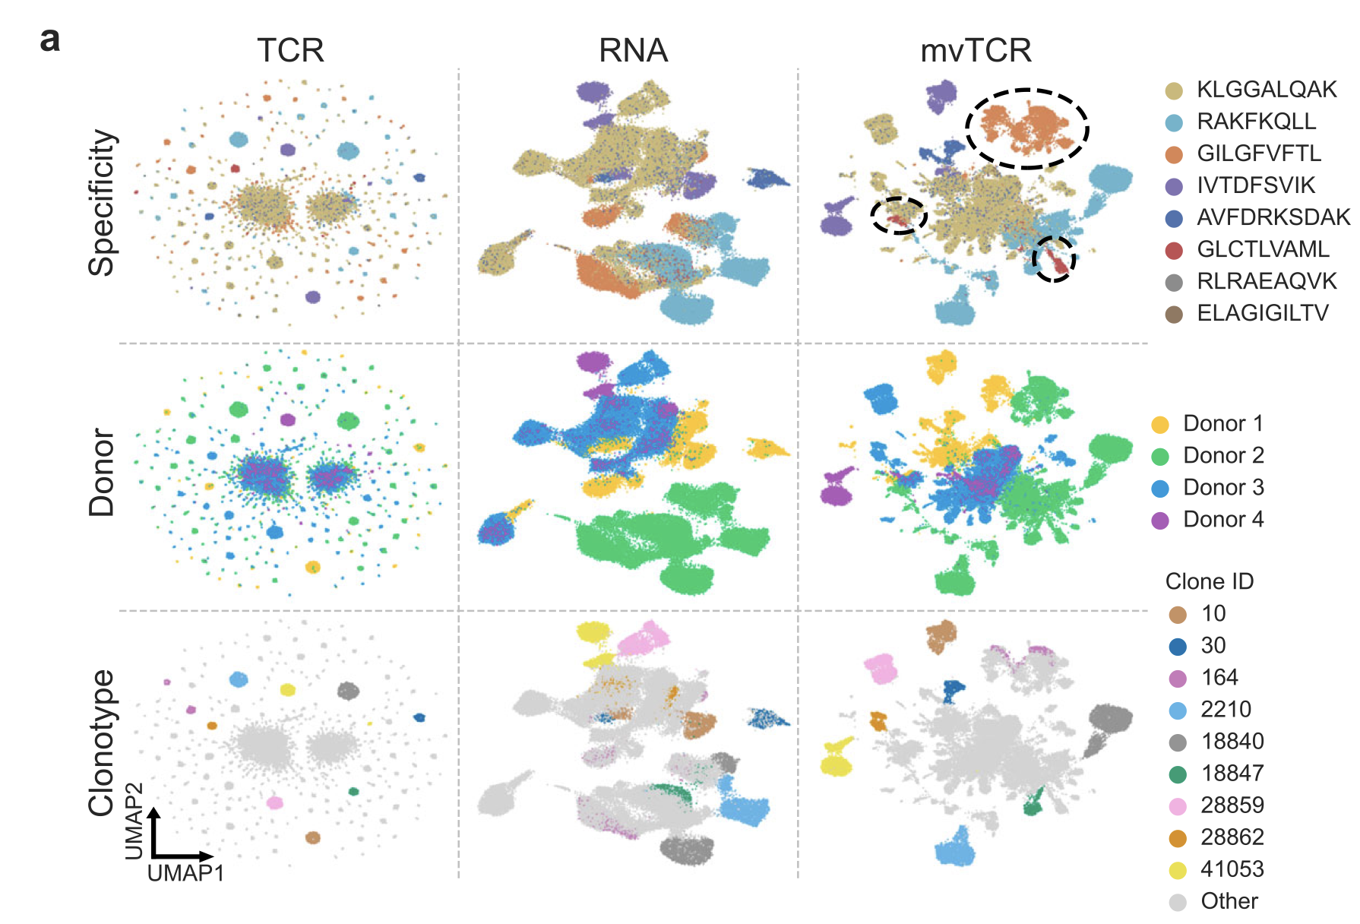
mvTCR enables analysis of cell function and phenotype
a UMAP visualizations comparing the embeddings of the unimodal (RNA, TCR) and the multimodal mvTCR models colored by peptide-MHC (pMHC) specificity, donor, and ten largest clonotypes. B Comparison of RNA clusters to mvTCR clusters with respect to antigen specificity
Notes:
what extent a joint T cell embedding improves the prediction of antigen specificity while preserving modality-specific variation. To this end, we used a dataset from 10x Genomics with binding annotations si of 44 epitope peptides bound on Major Histo- compatibility Complex (pMHC) multimers for four donors
We applied mvTCR to the T cells with specificity towards the eight most common pMHCs (Fig. 2, Supplementary Fig. 2), resulting in 61,237 cells in total. To compare multi- and unimodal representations, the repertoires of all donors were jointly embedded with uni- and multi- modal versions of mvTCR. The resulting representations were clustered via the Leiden algorithm21, where the resolution was chosen to maximize the NMI between pMHC specificity and cluster annotation
The unim- odal embedding trained solely on xTCR (Fig. 2a col.: TCR) was dominated by large clonotypes, which form separated clusters of distinct specifi- cities. This was reflected by larger number of clusters (n = 214) at a lower Normalized Mutual Information (NMI) of 0.408. Further, the embed- dings of different clones did not follow a clear transcriptional pattern to differentiate cell type from each other, which was expected as the TCR does not inherently capture this annotation. In contrast, the tran- scriptomic model trained on xRNA (Fig. 2a col.: RNA) led to a more continuous representation, which formed several antigen-specific groups with an NMI of 0.456 at n = 22 clusters (Supplementary Fig. 3).
In the RNA model, various subpopulations such as T cells binding to GLCTLVAML remained hidden, which were observable in the multimodal mvTCR models (Fig. 2a col.: mvTCR, Supplementary Fig. 2 col.: mvTCR, Concat, PoE). The mvTCR repre- sentation was able to combine clonotype and cell type information, simultaneously (Fig. 2a, Supplementary Fig. 2), leading to an NMI of 0.535 (n = 15 clusters, Supplementary Fig. 3). While 94.4% of the T cells specific to GILGFVFTL fall into three RNA clusters, 96.5% are contained in only one mvTCR cluster of 99.2% purity (Fig. 2b).
Remarkably, we observed a compact clustering of expanded clonotypes within all three representations persisting even in the RNA-derived model (Fig. 2a), consistent with recent findings suggesting a phenotypic imprint within cells of a clonotype1–3

Slide 6
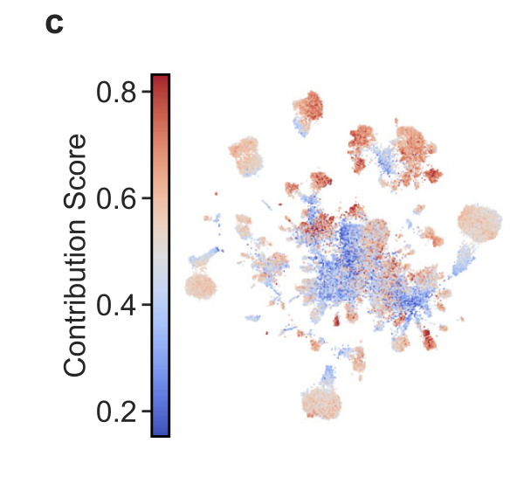
mvTCR provides the contribution of modalities to representation for each cell
c UMAP visualization colored by the contribution of TCR sequence information on the joint representation. Values <0.5 represent the dominance of RNA information and values >0.5 the dominance of TCR information.
Notes:
In the RNA model, various subpopulations such as T cells binding to GLCTLVAML remained hidden, which were observable in the multimodal mvTCR models (Fig. 2a col.: mvTCR, Supplementary Fig. 2 col.: mvTCR, Concat, PoE). The mvTCR repre- sentation was able to combine clonotype and cell type information, simultaneously (Fig. 2a, Supplementary Fig. 2), leading to an NMI of 0.535 (n = 15 clusters, Supplementary Fig. 3). While 94.4% of the T cells specific to GILGFVFTL fall into three RNA clusters, 96.5% are contained in only one mvTCR cluster of 99.2% purity (Fig. 2b).
To investigate the influence of each modality on the learned representation, we devised a mechanism to infer modality-specific scores (Methods TCR-Contribution). These contribution scores range from complete RNA dominance at 0% to only TCR information at 100% (Fig. 2c) and represent the respective similarity between ziRNA and ziTCR to zijoint. The four highest average contributions of the TCR sequences were observed in the pMHCs mentioned above: GILGFVFTL (55.4%), GLCTLVAML (54.8%), IVTDFSVIK (53.0%), and ELAGIGILTV (51.8%). This indicates that the model prioritized TCR information for these cells compared to the cells of the remaining dataset (Fig. 2d)
This is cor- roborated with TCR similarity estimated by the well-established TCRdist method19, which also indicated an elevated TCR sequence similarity for specificity groups of high TCR-contribution, with RAKFKQLL as the only outlier (Fig. 2e). Further, the average TCR- contribution per specificity and the TCR similarity show a positive
Pearson correlation of 0.64 (Fig. 2f).
Overall, these results indicate that mvTCR complements its joint embedding with information from both transcriptome and TCR sequences, leading to a more holistic cell representation capturing phenotype and functionality at the same time.

Slide 7
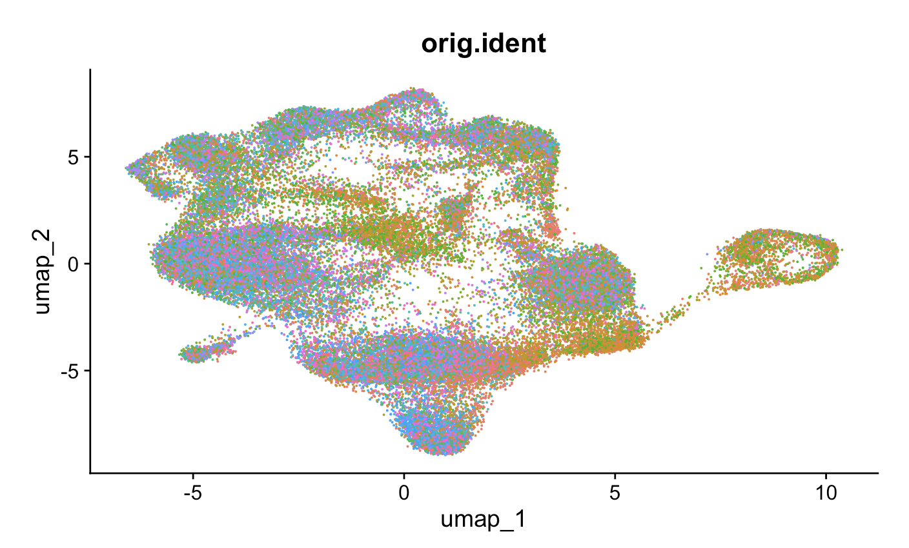
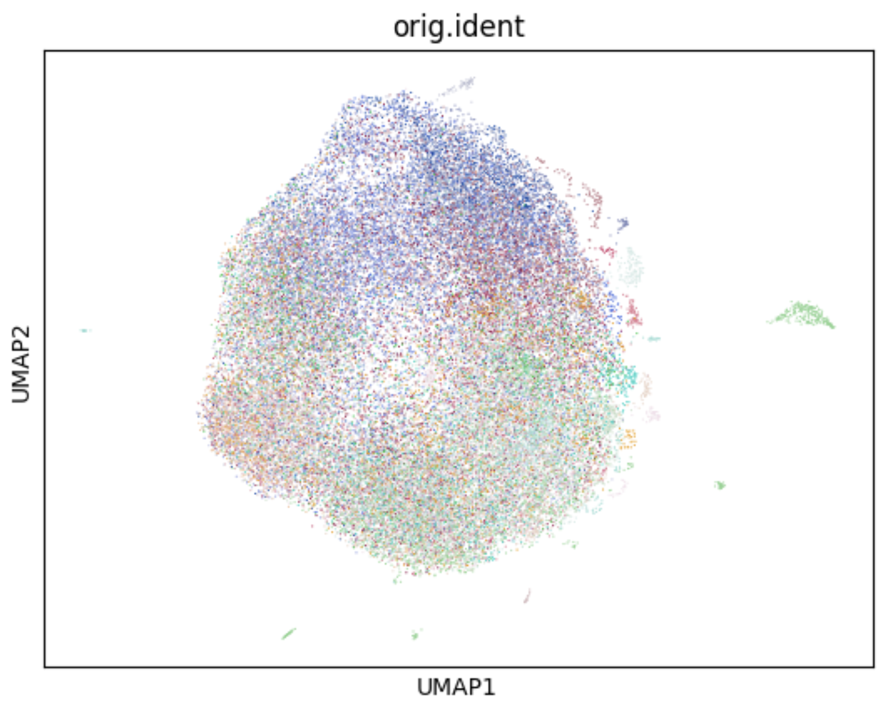
RNA (Seurat) vs. RNA+TCR (mvTCR) UMAPs: patient ID
RNA
RNA + TCR

Slide 8
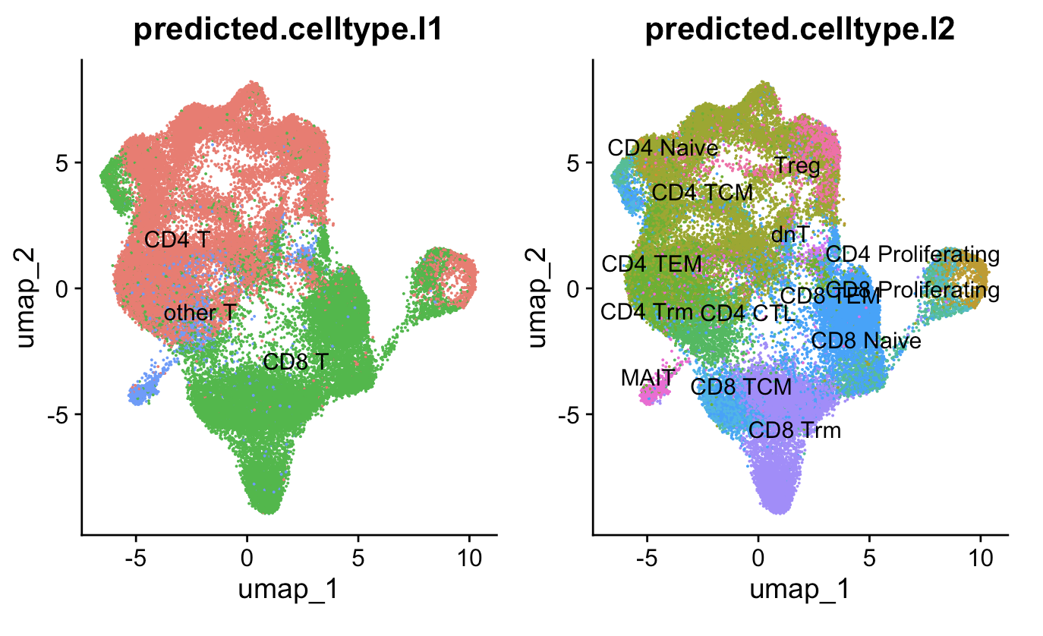
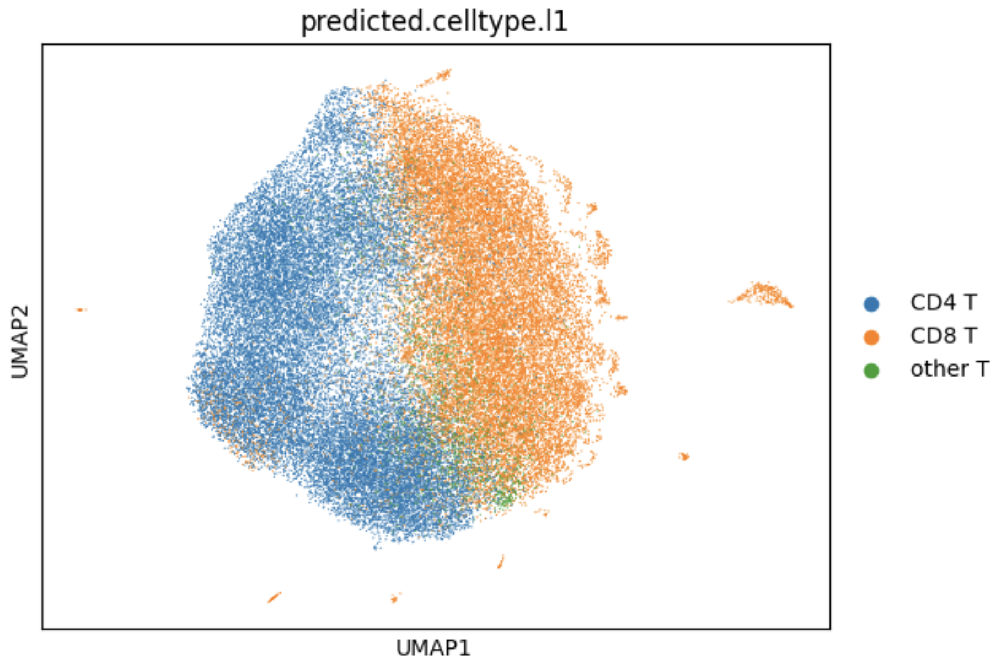
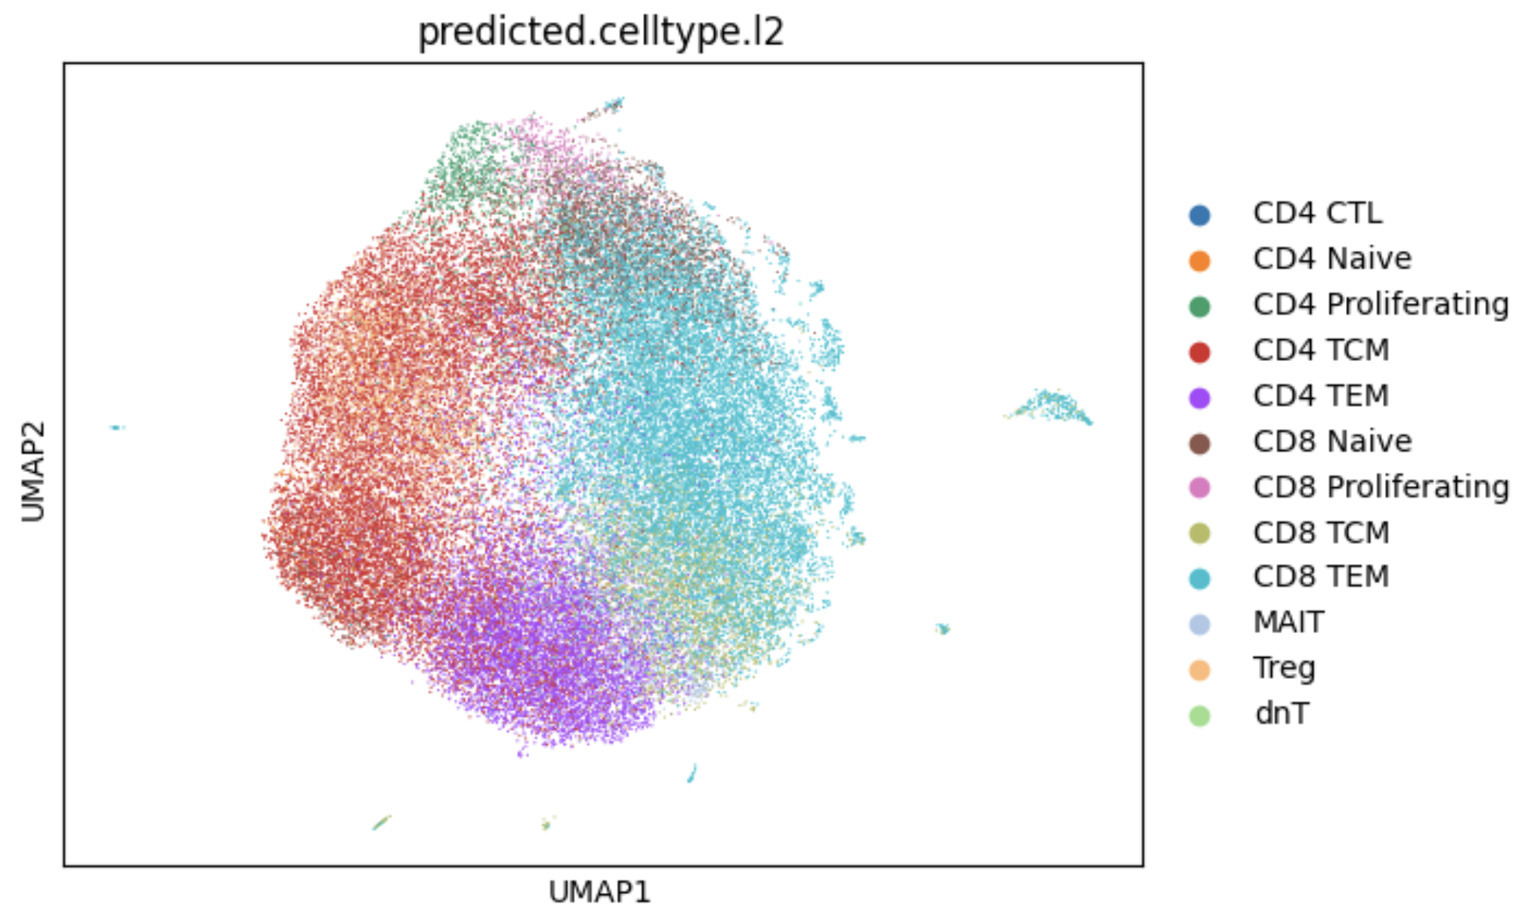
RNA (Seurat) vs. RNA+TCR (mvTCR) UMAPs: cell type
RNA
RNA + TCR
Notes:
NEXT STEP: identify the DEG of clusters which depend both on specificity and transcriptional signatures

Slide 9
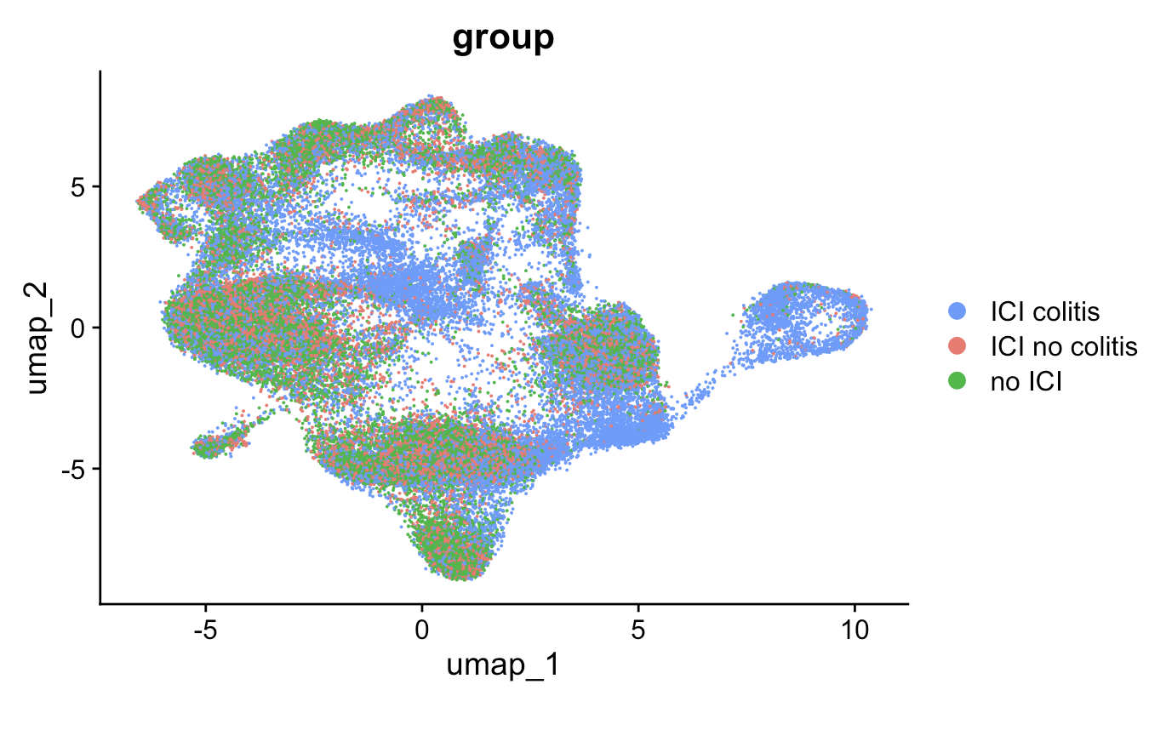
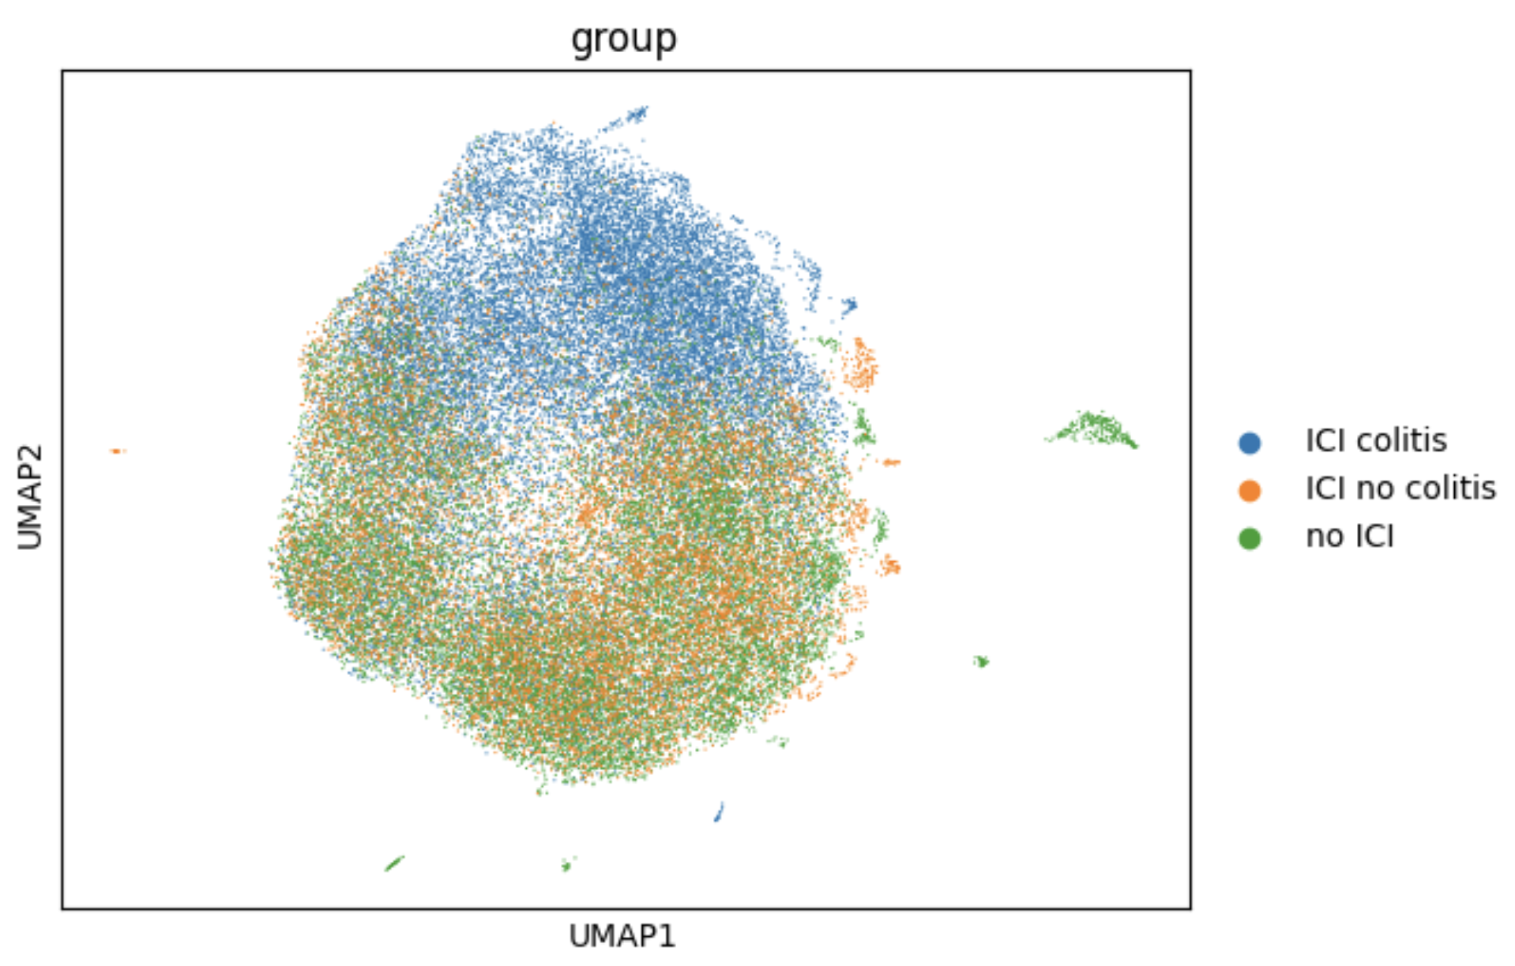
RNA (Seurat) vs. RNA+TCR (mvTCR) UMAPs: irAE status
RNA
RNA + TCR
Notes:
NEXT STEP: identify the DEG of clusters which depend both on specificity and transcriptional signatures

Slide 10
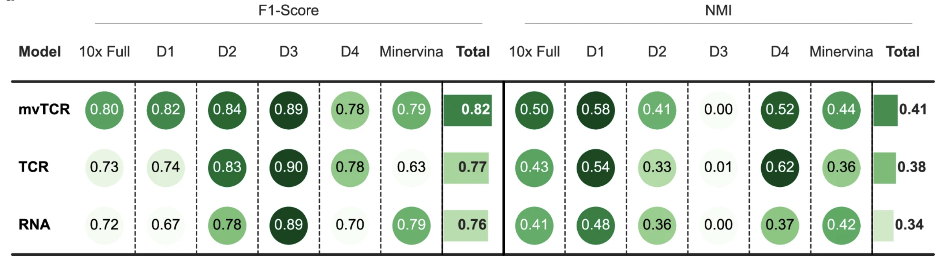
mvTCR captures antigen-specificity
a Predictions of antigen specificity were made on the 10x Genomics dataset for all donors (10x Full), donors 1-4 separately (D1-D4), and the Minervina dataset. Each score represents the average over five random splits (n = 5).
Notes:
quantitatively evaluated mvTCR’s capability to capture antigen specificity. We retrained mvTCR on the 10x dataset pooled over all donors and separately for each donor on five different ran- dom splits. Additionally, we included the dataset by Minervina et al.24 (Minervina dataset), which contains specificity annotation for pMHC-dextramers against 18 SARS-CoV-2 related epitopes for 8,618 cells from 55 vaccinated donors (Methods Datasets). After training the model, a hold-out set was projected onto the training set and the cells’ specificity was predicted by a k-Nearest-Neighbor (kNN) model. Note that mvTCR was trained only on clonotypes not con- tained in the holdout set to ensure unbiased performance estima- tion. Of the three tested approaches to fuse TCR and GEX information (Methods Network Structure), the MoE performed better on average than the PoE and the Concatenation mixture module (Supplementary Fig. 9), and was therefore used as the main mixing module for the mvTCR model.
compared mvTCR against baselines trained only on TCR or tran- scriptome information (Fig. 3a)
On average, mvTCR (F1-Score: 0.821) significantly outperforms both the TCR model (F1-Score: 0.767, p-value: 0.0051, one-sided paired t-test) and the RNA model (F1-Score: 0.759, p- value: 0.0016). In the individual datasets, mvTCR outperforms the unimodal baselines in 7 out of 12 cases during atlas-query prediction while performing on par with the better-performing modality. Often, specificity was either dominated by TCR (donors 1, 2, and 4) or RNA information (Minervina dataset) as shown by better prediction using this modality. To validate that mvTCR focuses on the relevant information, we calculated the contribution of each modality to its representation. We observed a significant Pearson correlation of 0.757 (p-value: 1.3e-6) between the average contribution of TCR information in a dataset to the embedding and the F1-Score quotient of the TCR over the RNA model (Fig. 3b).
Depending on the dataset either TCR or transcriptomic infor- mation is more indicative of antigen specificity. However, mvTCR adapts to the datasets by focusing on the most informative modality to a larger degree.
when cells of the same clonotypes have more diverse gene expression profiles in a dataset mvTCR incorporates less TCR information. As mvTCR was able to fuse both modalities at a task- appropriate weighting for each dataset, it was better suited than uni- modal approaches to predict antigen specificity
compared mvTCR against tessa for predicting and clustering antigen specificity (Fig. 3c, tessa uses the CDR3β sequence as the only input for representing the TCR, so they retrained mvTCR without the TCRα sequence.
We sought to evaluate whether mvTCR can not only predict antigen-specificity but also quantify the binding. As binding avidity depends on the binding strength of the individual TCR as well as the cell state25, a joint representation might be ideally suited for this task. Therefore, we trained an additional neural network that received the embedding as input to predict the counts of detected for pMHC multimers as an approximate measure of avidity ai (Methods Avidity Prediction). The performance greatly varied between datasets, as the prediction was biased toward pMHCs mostly recognized by heavily expanded clonotypes. Again, a multimodal embedding proved bene- ficial (Fig. 3d,
performance improves when the training size increases but begins to saturate at 2500 cells with only a minor increase afterward (Fig. 3e).

Slide 11
Extra slides

Slide 12
Previous methods
Scirpy, scRepertoire: interlinked unimodal analyses
CoNGA: detect correlations between TCR sequences and transcriptome
tessa: correlate modalities and cluster T cell clones by specificity
Gap in methods: no integrated representation for downstream analyses, scaled only to small-size datasets, only clonotype-level approaches
Notes:
Same clonotypes can have distinct phenotypes

Slide 13
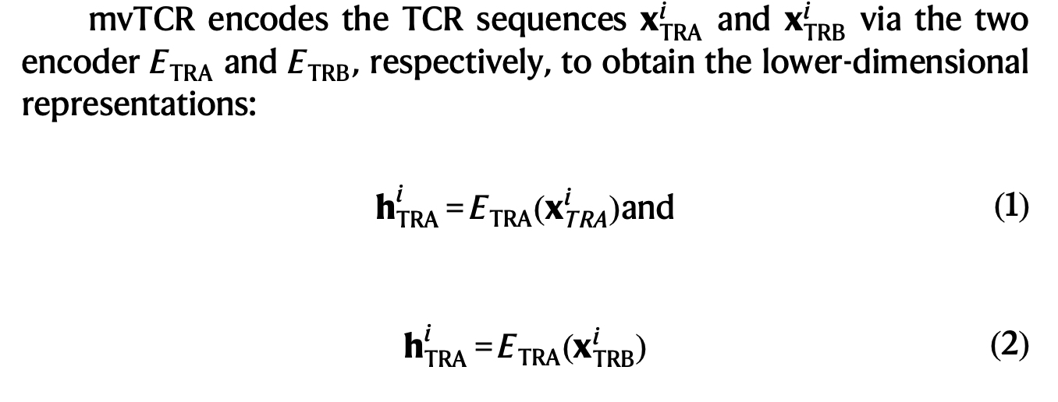
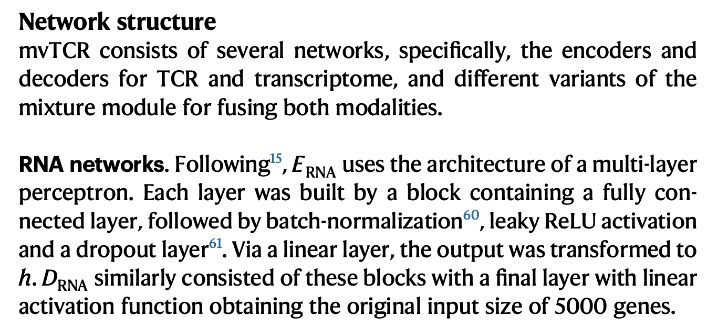
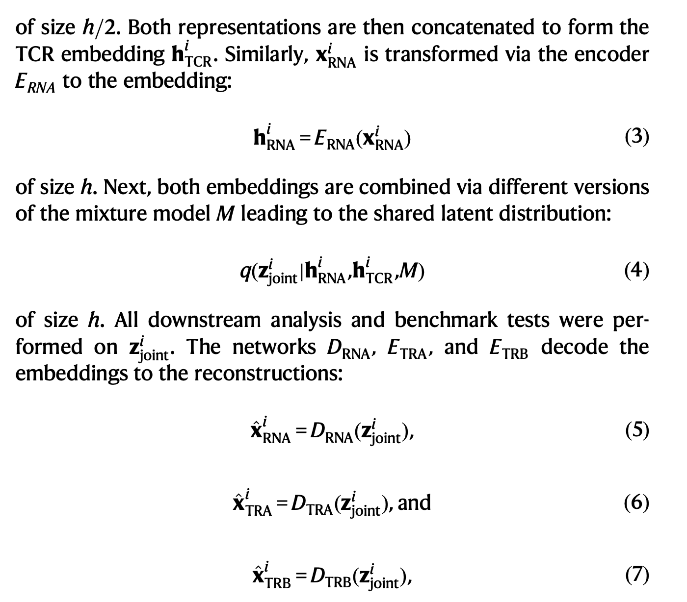
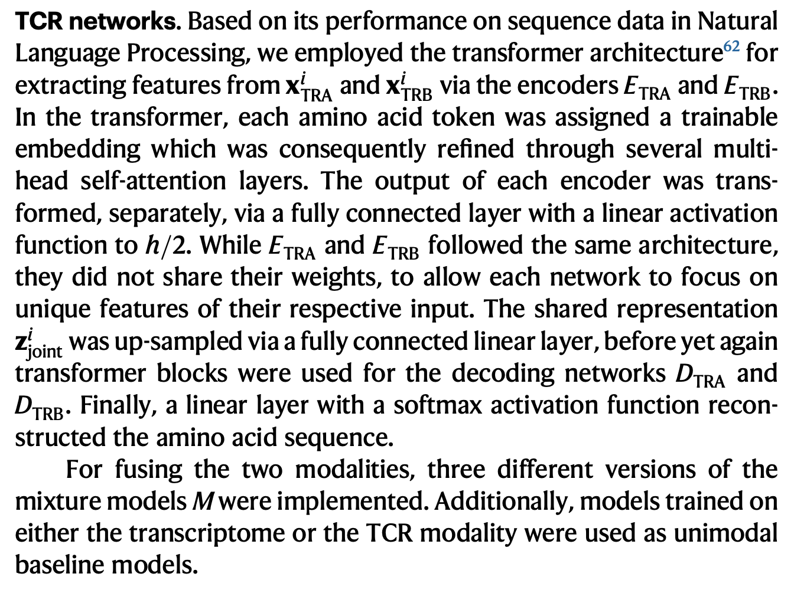
Methods

Slide 14
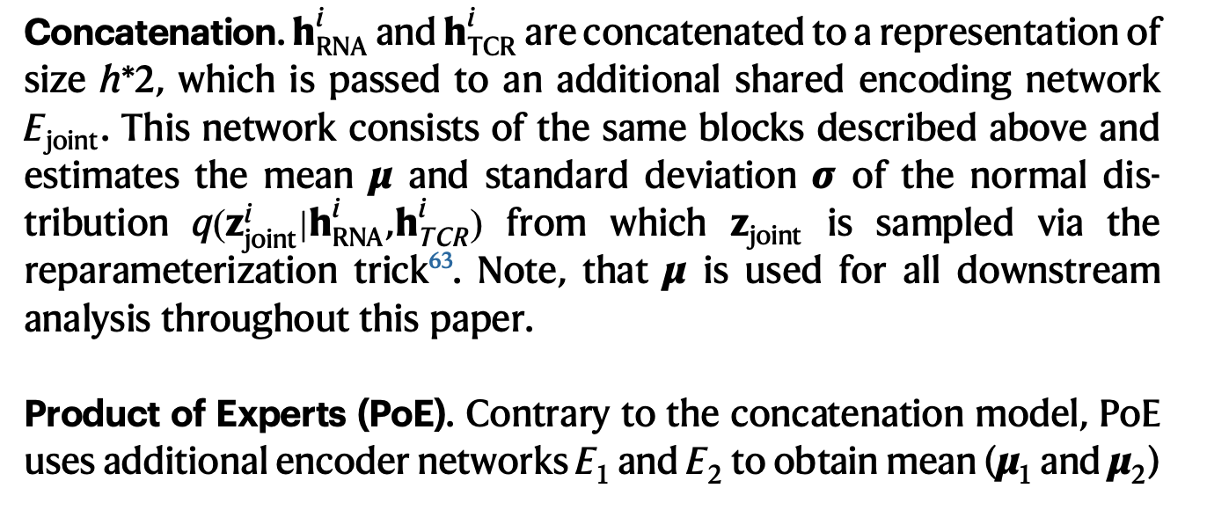
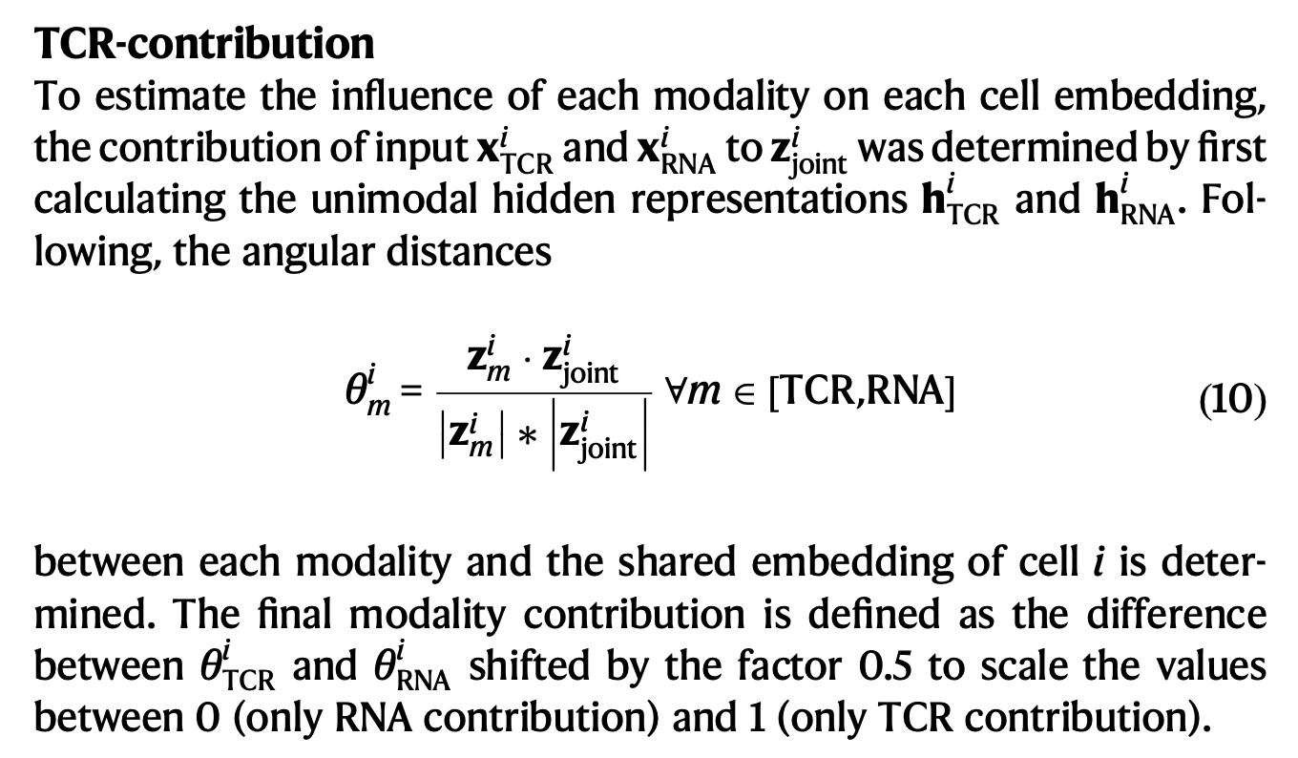
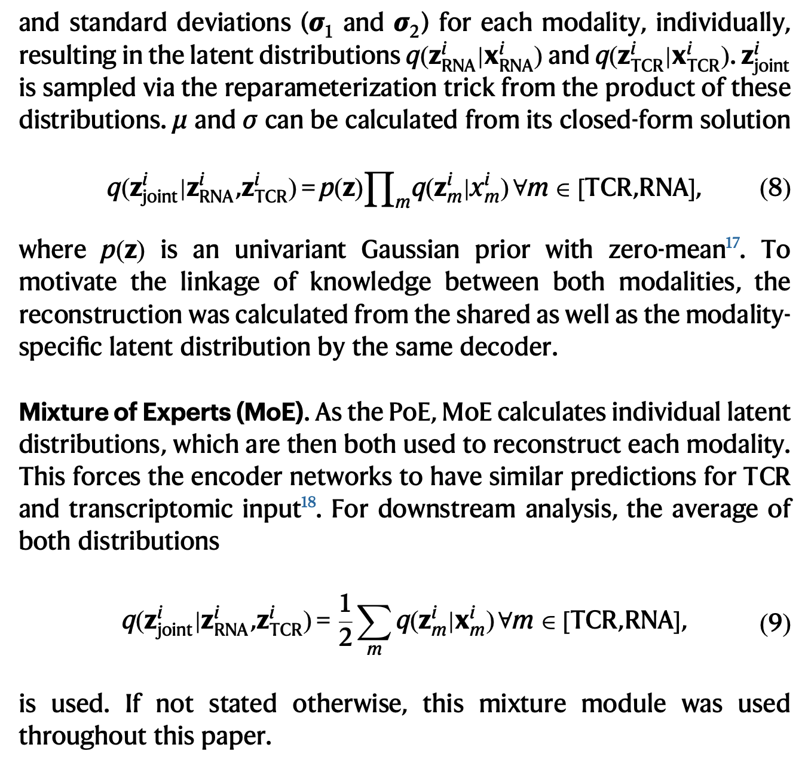
Methods

Slide 15
mvTCR can help distinguish T cells binding SARS-CoV-2 antigens from bystander cells
mvTCR on Peripheral blood mononuclear cells (PBMCs) from 130 patients diag- nosed with SARS-CoV-2 virus with varying severities
resulting mvTCR latent representation (Fig. 4a) separated groups of CD8+ effector T cells that expressed a high interferon (IFN) response score38, which were captured by fine-grained Leiden clustering (Fig. 4b,c).
fter selecting these clusters of elevated IFN response scores (one-sided, unpaired t-test, p-values < 0.001, Fig. 4d, Supplementary Data 1), we observed that all 13 resulting clusters contained almost exclusively (99.1%) cells from donors with symptomatic SARS-CoV-2 infection (Fig. 4e).
TCRs were queried to the Immune Epitope Database (IEDB)43, which revealed 1839 cells with possible cognate epitope matches (Methods Datasets), which were reduced to 1342 matches, when filtering out epitopes that were not predicted to bind to the corresponding donors’ HLA-types (Supplementary Data 2) via MHCFlurry 2.044 (Fig. 4f, Supplementary Data 3). Based on this query, we identified five SARS-CoV-2-specific and three bystander clusters. On average, the cells from SARS-CoV-2-specific clusters originated from earlier time points after symptom onset (7.7 days) compared to the bystander clusters (10.1 days) and the remaining clusters (11.6 days) again indicating an antigen-specific T cell response (Fig. 4g).
Notes:
Bystander T cells are activated by immune signaling without recognition of their cognate antigen41 and were reported to play a crucial role in the different severity degrees of COVID-19 patients

Slide 16
Conclusions
mvTCR enriched transcriptomic information with clonality, allowing us to identify the DEG of clusters which depend both on specificity and transcriptional signatures. This cannot be obtained by the analysis of individual modalities, demonstrating that the integration of multiple modalities using mvTCR enables the discovery of novel knowledge that would have been missed in unimodal approaches.

